Slide 1

Medical Store Management
Prepared By:-
Rezwan Ahmed Shurid Kazi Afrin Jimi

Slide 2
1. Introduction
Medical Store Management System t is very helpful to manage sales information of Medical Store. It can easily keep the record of Hospitals who done regular business deals. This software is comprehensiveness and the simple by which it handles complex tasks easily.

Slide 3
Project Profile
Project Title: Medical Store Management
Project Concept: Industrial project(Salse management, generation of reports and bills)
Type of Project: Desktop/Windows Application

Slide 4
SOFTWARE CONFIGURATION
Software required for development:
Operating System:
Windows XP/Windows vista
Front End :
Microsoft Visual Studio 2008 (Offline)
PHP, HTML, Javascript (Online)
Back End :
Microsoft SQL Server 2005 (Offline)
My SQL (Online)

Slide 5
HARDWARE CONFIGURATION
Hardware requirement for development:
Processor:
Pentium IV500MHz or higher
Memory-RAM:
128MB or higher RAM
Memory-CACHE:
128MB or higher RAM
Hard Disk:
40GB or higher

Slide 6
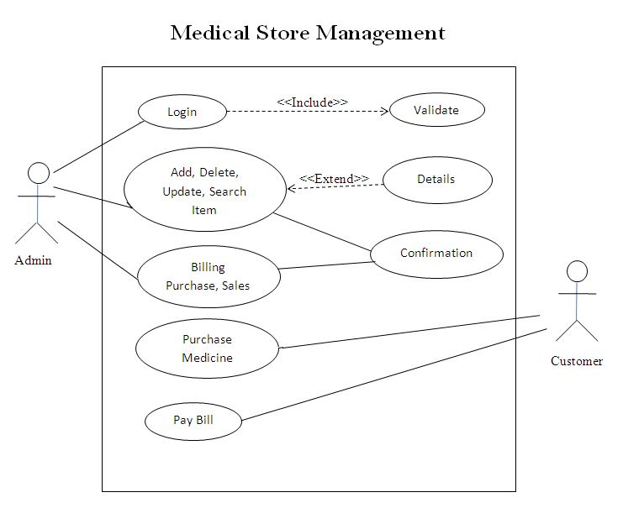
Use case Diagram

Slide 7
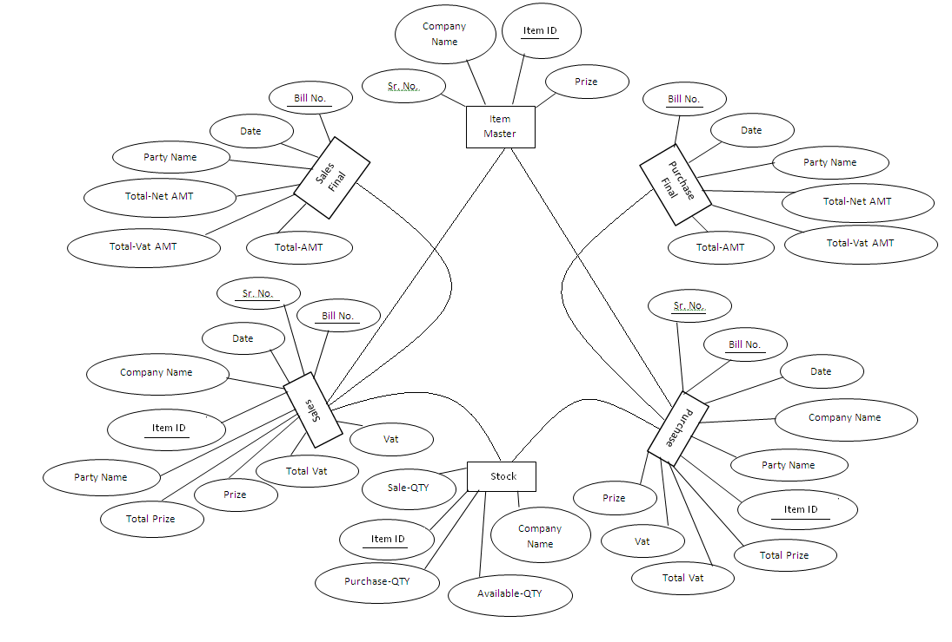
E‑R diagrams

Slide 8
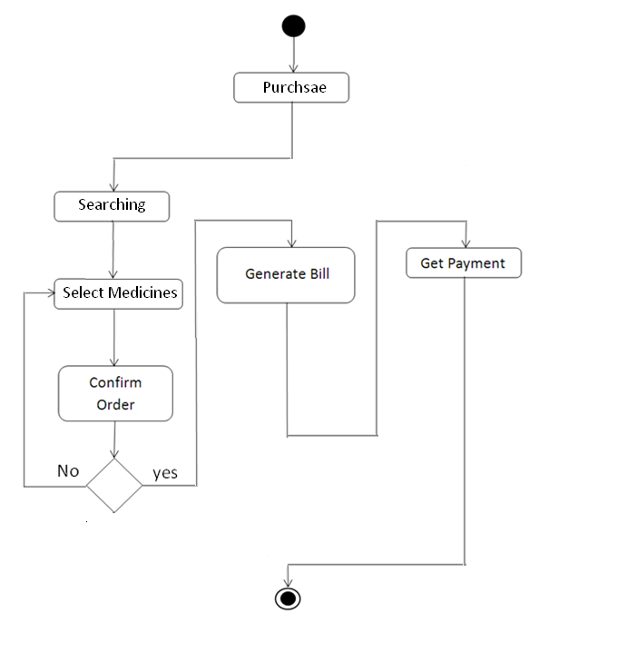
Activity Diagram

Slide 9
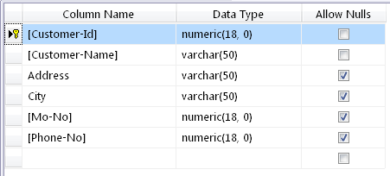
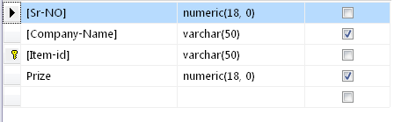
DATA DICTIONARY
Customer Master:
Item Master:

Slide 10
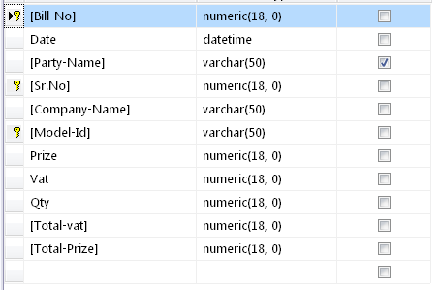
Purchase:

Slide 11
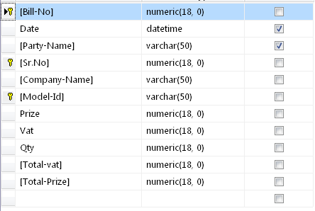
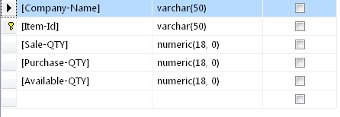
Sales:
Stock:

Slide 12
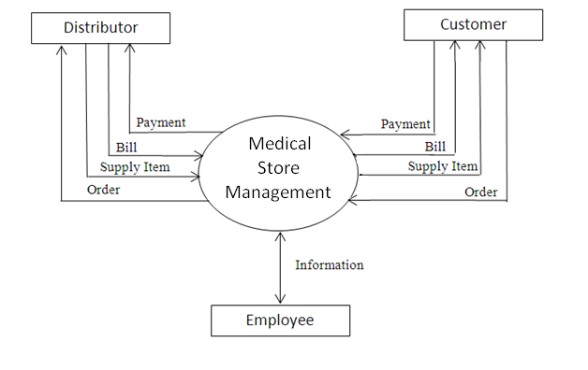
Context Diagram

Slide 13
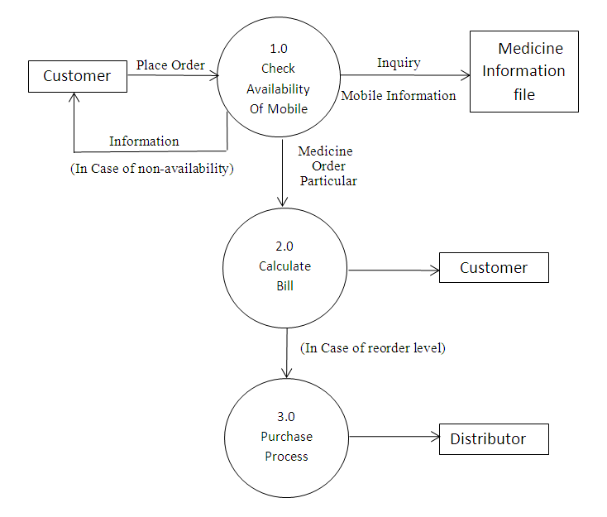
Data Flow Diagram (level 0)

Slide 14
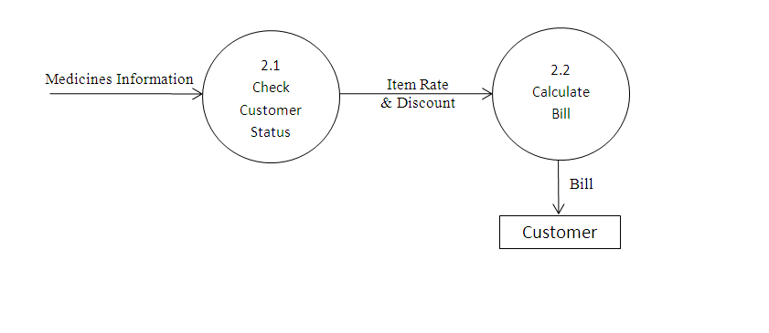
Data Flow Diagram level 1

Slide 15
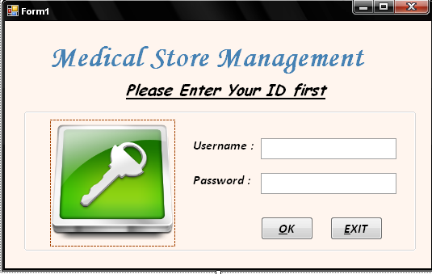
SCREEN SHOTS AND USER MANUAL
Login Form

Slide 16
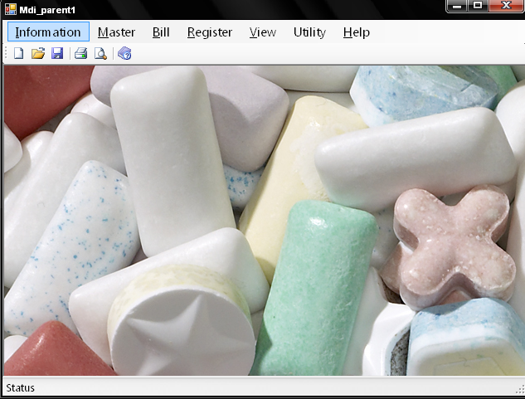
Mdi Parent

Slide 17
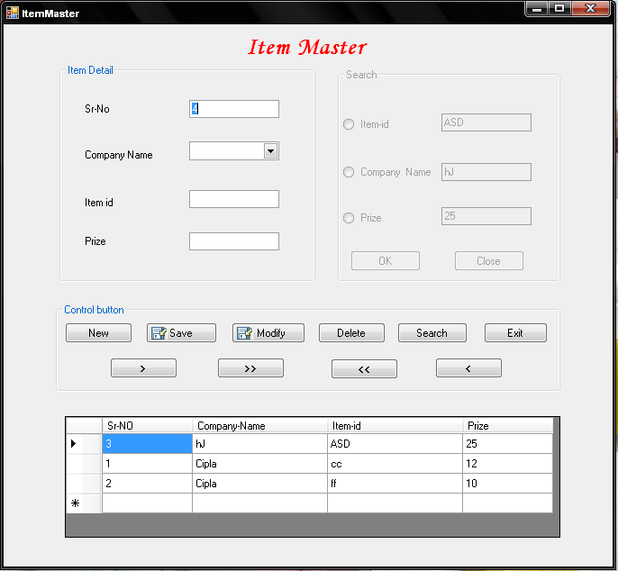
Item Master

Slide 18
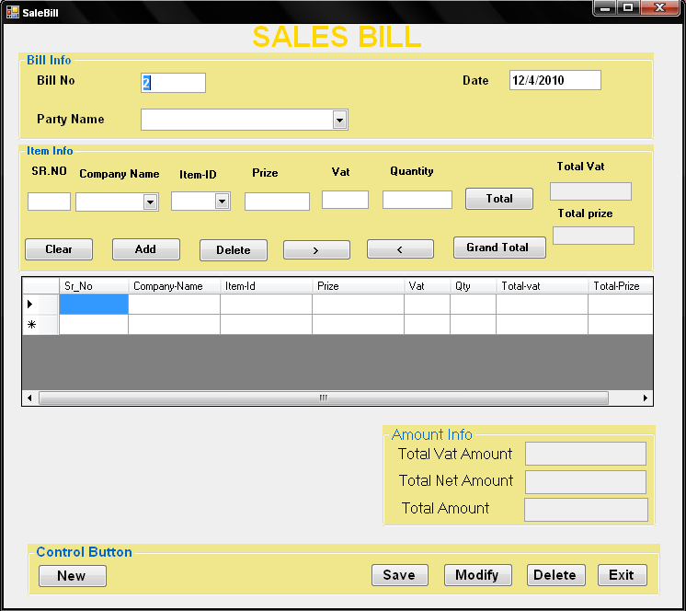
Sales Bill

Slide 19
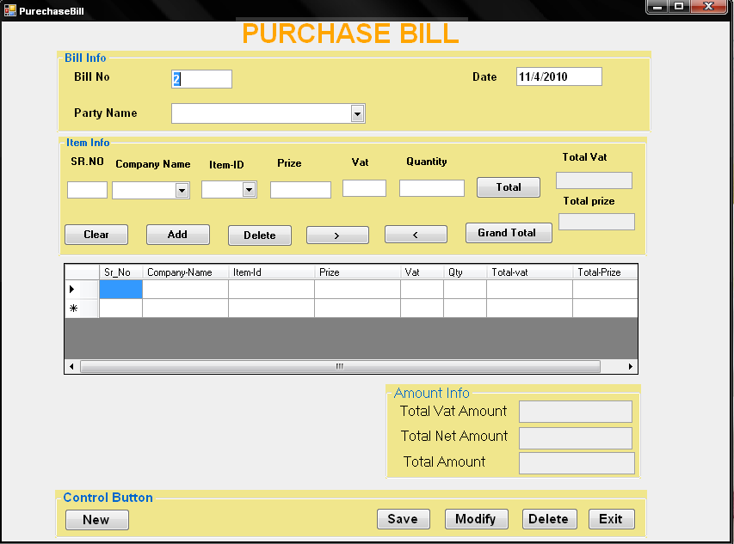
Purchase Bill

Slide 20
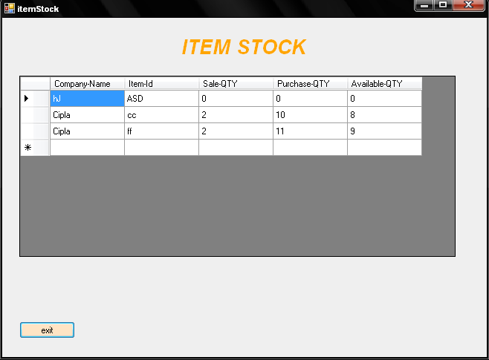
Item Stoke

Slide 21
Limitations
Limitation:
There are many kind of advantages for application but some amounts of limitation are available in this system.
These certain limitation is following here :
SQL server is must be required in the software
It can’t be used big medical Firms, it only applicable for small Units.
No interactive designs are included in the software.

Slide 22
Future expansion
In next version master can change rate & type of Medicines company& rate.
In next version master can change rate& type of the table.
As well as they can also add new Medicines details.
We will also include the new modules in next version.
Solve all the limitations of the project.
Create a data base in XML so system can be more flexible for various Operating Systems.

Slide 23
Conclusion
This process system is more easy and reliable to use then manual system.
There is a security system with password in the system that the manual system never had and there was theft of the data being stolen.
There are difference forms for every record, there necessary to company to have maintained of data.
There is also feature of showing the previous customer detail.
Finally we have to come to the conclusion that whatever the medical store requirements is present in this software.

